Slide 1


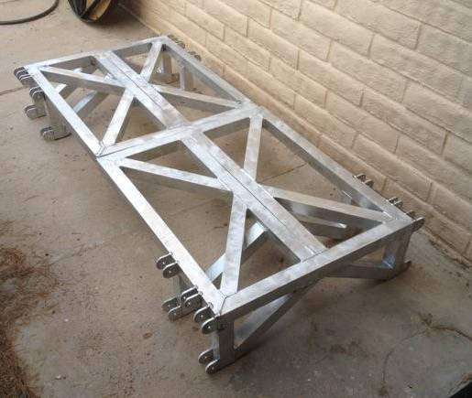
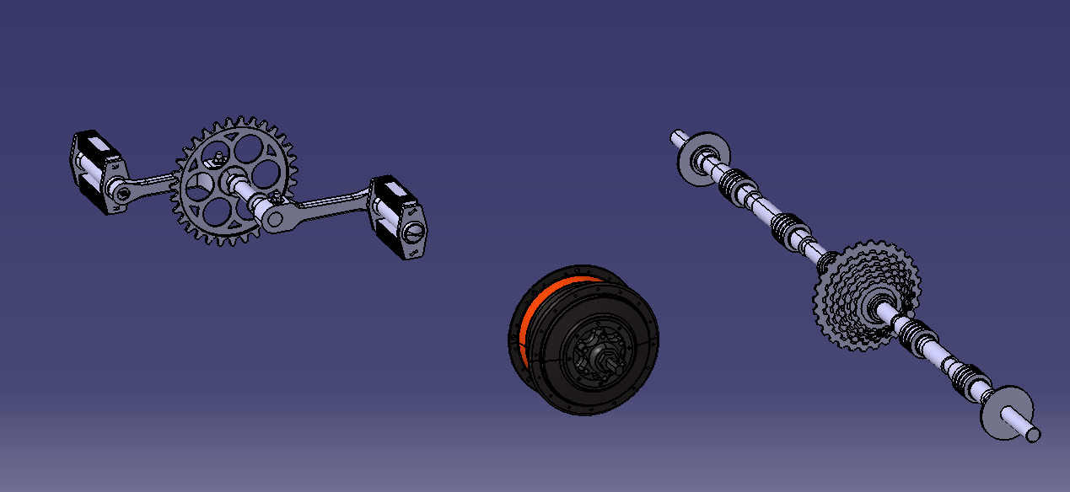
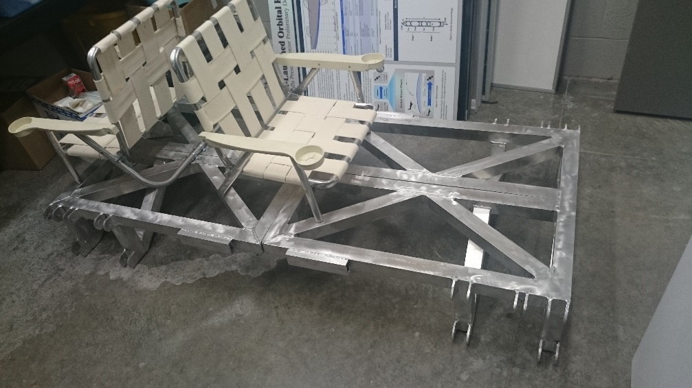
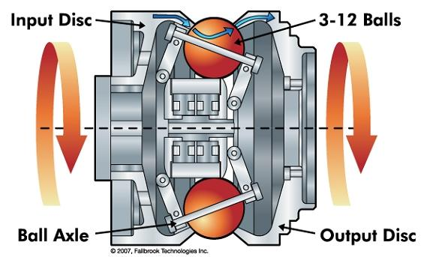
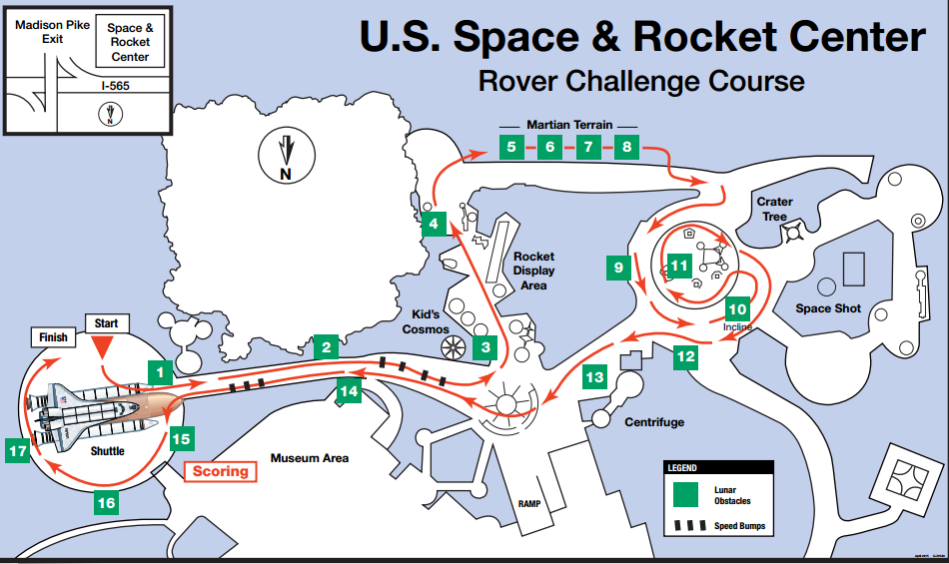
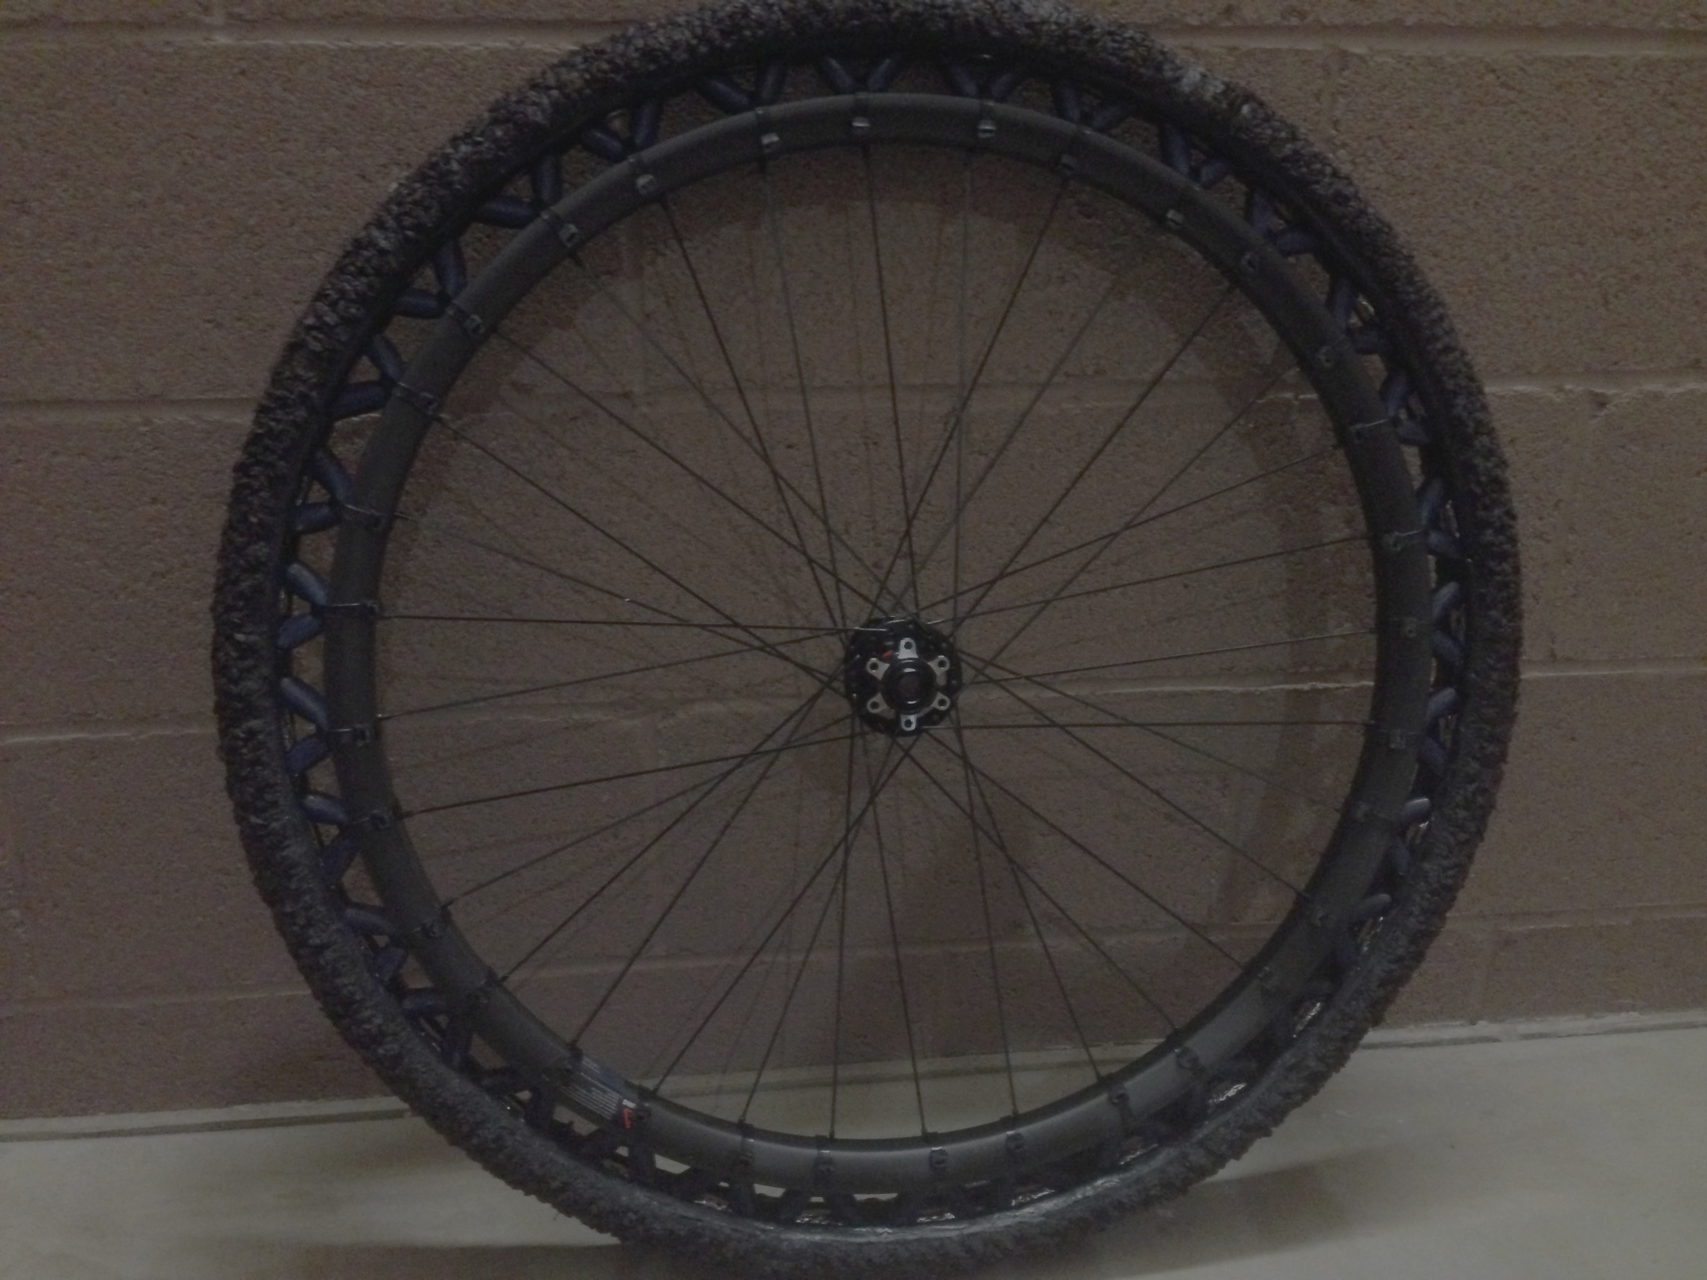
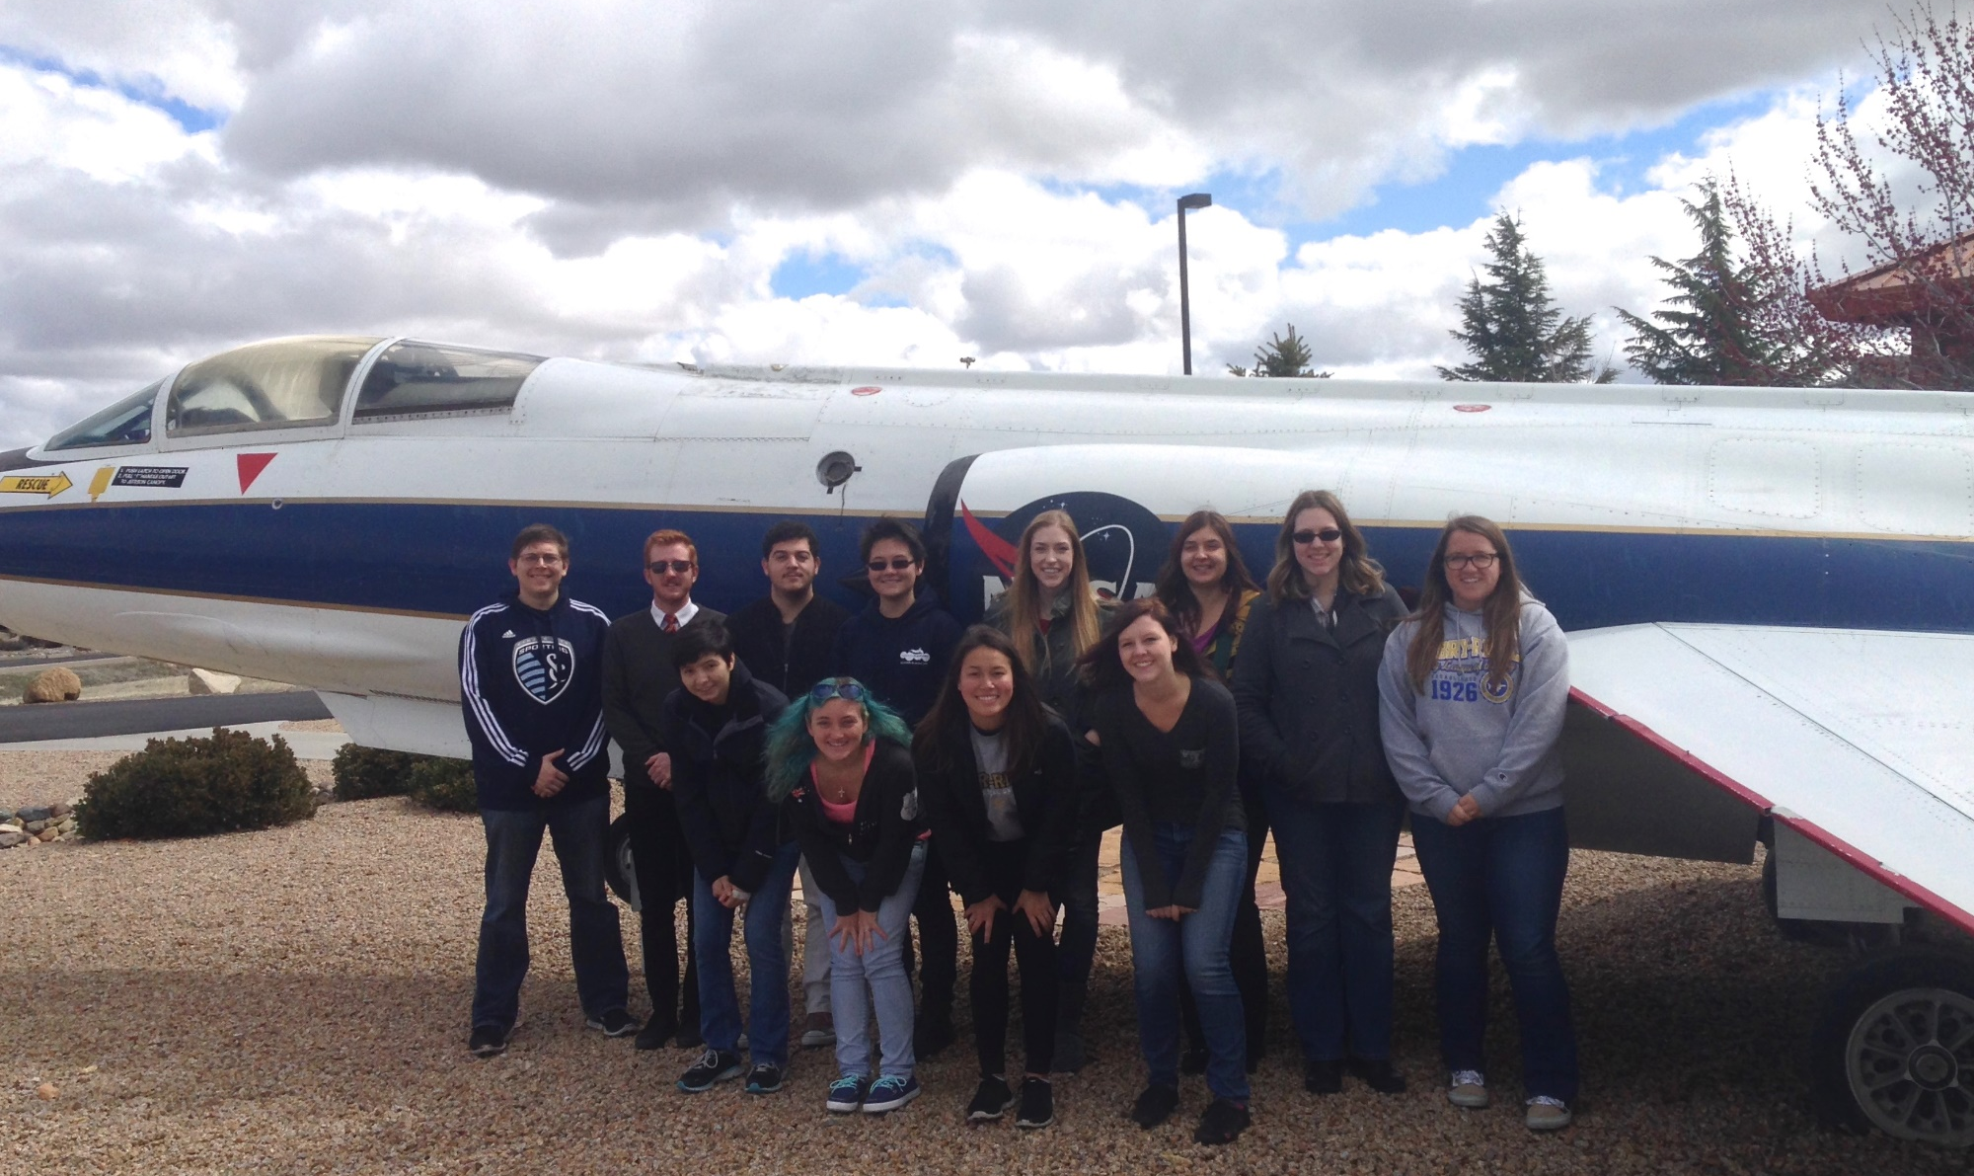
Society of Women Engineers Moonbuggy Project
Team Ocelot, Dr. Brenda Haven
Department of Aerospace & Mechanical Engineering, Embry-Riddle Aeronautical University, Prescott, AZ
Structure
Abstract
Drivetrain
The frame consists of an aluminum 6061 rectangular truss that is be a total of 6 feet in length and 2.5 feet in width. The frame folds in the middle utilizing a hinge and lock system to allow for the buggy to fit within the design package constraints. The aluminum properties were tested using CATIA material analysis and finite element analysis.
The purpose of this project is to give students an opportunity to gain valuable hands-on engineering experience. The students participating in this project are designing and building a human-powered vehicle to be used as an outreach tool by the university and the Society of Women Engineers. The vehicle will be used at outreach events to allow people to experience an interactive example of the work that students do at Embry-Riddle, it will also garner interest in STEM careers from school aged children by giving them a hands on experience. The skills gained during this difficult engineering project will be applicable to other engineering courses, especially senior capstone projects. Students working on the project gain experience in design, fabrication, leadership, and teamwork. This project gives student the unique experience of working on a full-scale engineering project as early as their freshman year. This vehicle will be used in future years to participate in the NASA Human Exploration Rover Challenge
The drivetrain subsystem includes a NuVinci CVT bike transmission that will send power to a free wheel differential that will ensure smooth wheel rotation while turning. Both drivers are providing power to an axel providing power to all four wheels. The advantage of the CVT in this situation is that both drivers are able to pedal at a setting that is most comfortable to them.
Competition Information
The Human Rover Exploration Challenge covers a 0.7 mile track around the United States Space and Rocket Center, weaving in between historic rockets and through a simulated patch of the lunar surface. The course consists of a series of difficult obstacles including gravel mounds, deep sand patches, and steep inclines, all designed to push the rovers and their riders to their limits.
Wheels and Tires
Driver Safety
We are currently using Britek’s energy return wheel on our rover. These wheels provide some suspension to the rover due to the elastic bands that secure the tire to the wheel. These tires will not be used during the competition next year due to a rule change that bans the use of commercial tires. The team will work to design and manufacture non pneumatic tires for use in the competition.
Vehicle Overview
As the riders will be traversing difficult obstacles at high speeds and steep inclinations, safety is of the utmost concern. This will be addressed through two main categories: safety restraints, and rider wear. To help provide sufficient lumbar support to the drivers, we are designing our own seats. As required by NASA rules, our riders will wear gloves, goggles, and long pants and shirts to protect from debris and accidents.
Collapsible, must fit within 5ft cube
Human Powered
Two people must be able to carry vehicle
15” above ground
Turning radius of 15 feet or less
Pneumatic tires are not allowed
Simulated electronic equipment
Steering
Currently the rover’s steering system consists of brake-steering which allows the rover to turn by reducing the rate of rotation of one of the wheel which allows the rover to be steered in the direction of the slower wheel. The steering system will be updated next year to include cable steering which will all the driver to steer using a steering wheel. Cable steering was chosen because the placement on the steering cable can easily be changed. Another advantage is that this method of steering will not add a significant amount of weight to the rover.

